Slide 1
Promoting collaborative engagement and strengthening strategic partnerships: PHE and local authorities working together on public health intelligence
Kate Sweeney, PHE
Andy Baker, Coventry City Council

Slide 2
Who are PHE?
Arms-length body of DH, formed on 1 April 2013
Brought together 70 organisations including the 8 former Public Health Observatories
Focus on population health and prevention/risk factors/inequalities
Approx 5500 staff based all over the country (220 working in knowledge & intelligence)
Our stated mission
We protect and improve the nation's health and wellbeing, and reduce health inequalities
Our responsibility to Local authority partners
To share our information and expertise to help LAs make improvements in the public’s health
To help local authorities to develop the public health system and its specialist workforce

Slide 3
Local Knowledge and Intelligence Service (LKIS)

Slide 4
Local analysis – Providing expert analysis for the local public health system, to help understand and address key public health priorities
Ad-hoc analysis and requests service
Providing analysis and benchmarking to inform business planning and local prioritisation of public health action
Local support for users of key technical tools and products including GIS and Return on Investment tools
Developing proof of concept pilots and other local projects to test new and innovative approaches including use of new data sources.

Slide 5
Local knowledge transfer – Active dissemination of national PHE K&I resources, supporting their local use and gathering feedback on their value
Providing key local messages and summary analyses from national products
Supporting delivery of webinars, workshops or other activities to disseminate national products and tools
Providing regular communications containing information about news, events, publications and data releases from PHE and other national bodies
Facilitating closer working between local users and national teams involved in the development and maintenance of PHE intelligence products

Slide 6
Local training and professional workforce development - developing capacity and capability of the wider public health workforce, with a specific focus on health intelligence
Facilitating, supporting and managing regional Health Intelligence Networks
Delivering a range of specialist public health intelligence courses
Delivering training sessions on public health intelligence for non-specialist staff in local authorities, partner organisations and throughout PHE
Facilitating and/or supporting commissioning of external training for local authority staff e.g. SQL training, based on locally identified priorities

Slide 7
Local Knowledge & Intelligence Service (LKIS) West Midlands - ‘Plan on a Page’ 2016/17
Strategic Vision
To support and advocate for effective local public health action in the West Midlands through the delivery of high quality tools & products, analysis, expert advice and training
We will deliver this via:
Local Analysis - Providing expert analysis for the local public health system, to help understand and address key public health priorities
Local Knowledge Transfer - Active dissemination of national PHE K&I resources, supporting their local use and gathering feedback on their value
Local Training & Workforce Development - Developing capacity and capability within the wider public health workforce, with a specific focus on health intelligence
Core Principles
Integrated working with local PHE Centre
‘Do once for all and share’
Cross-functional K&I working
High Level Objectives
Operate as part of a distributed national service working locally to deliver a consistent, responsive and high quality local knowledge and intelligence service as part of PHE Centres;
Actively disseminate national PHE K&I resources for local use, whilst gathering feedback on their value;
Develop approaches for working with devolved areas and combined authorities;
Develop a menu of public health intelligence support for Combined Authorities, including bespoke analysis for the WM Combined Authority and Mental Health Commission.
PHE Centre Data Surveillance & Peer Benchmarking to inform Centre planning and local prioritisation of public health action, as part of ongoing Centre and regional assurance processes.
Provide local input into WM STPs via signposting/advisory support to relevant PHE tools and data sources to inform local health & wellbeing ‘gap analysis’
Application of the Hub Diagnostic approach to stakeholder engagement with other LAs across WM
Key Local Projects
Provision of a high quality, locally responsive PHE expert knowledge and intelligence service to stakeholders
Delivery of a range of external training and workforce development activities including: modular training on PH intelligence; specialist training (e.g. data visualisation/infographics, HES etc.); placement/secondment opportunities.
Co-ordinate, support, plan & deliver regular local network events & workshops, e.g. WMPHIG
Coordinate and lead LKIS representation at key national conferences and events and develop a high quality set of supporting materials
Develop & implement a national programme of LKIS Webinars
Key Activities
Impact
Measures
High-quality delivery of the 16/17 work programme to the satisfaction of the Stakeholder Advisory Group
Positive stakeholder engagement and feedback from Local Authority Public Health Intelligence teams
Routinely inform PHE Centre planning and local prioritisation of public health action, as part of ongoing Centre surveillance and regional assurance processes, to the satisfaction of the PHE Centre Director.
1 x Associate Director (1.0 WTE)
1 x Principal Analyst (0.8 WTE)
1 x Senior Analyst (0.5 WTE)
2 x Knowledge Transfer Facilitator (1.4 WTE)
2 x Intelligence Analysts (0.5 WTE each)
Total Whole Time Equivalent (WTE) = 4.7
Email: LKISWestMidlands@phe.gov.uk
Resources

Slide 8
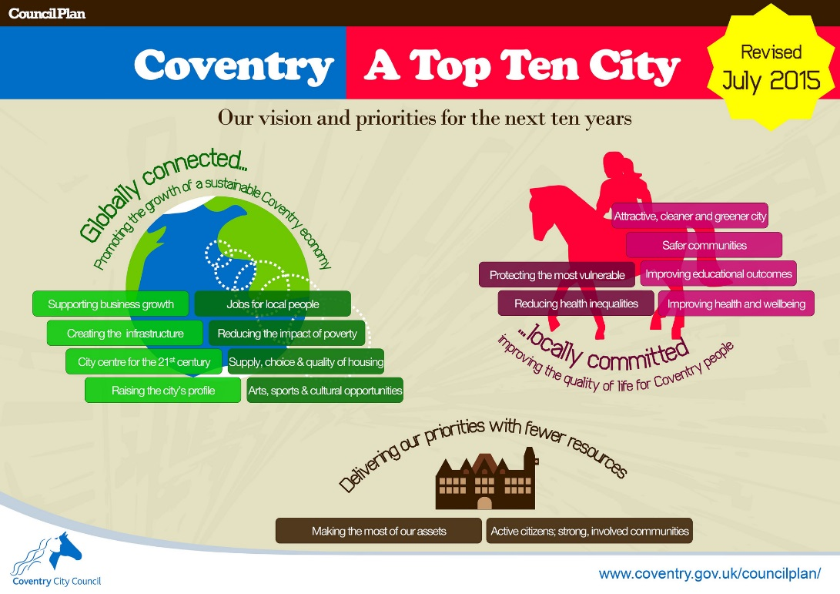
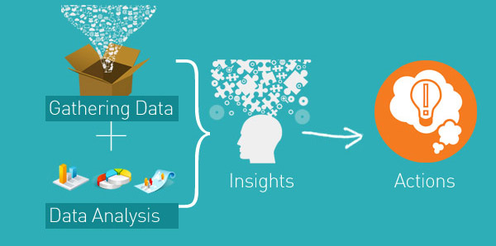
Intelligence, Engagement, Performance
Local partnerships with universities and other bodies to improve knowledge of city
Links with decision makers including elected members and members of strategic groups such as Health and Wellbeing Board

Slide 9
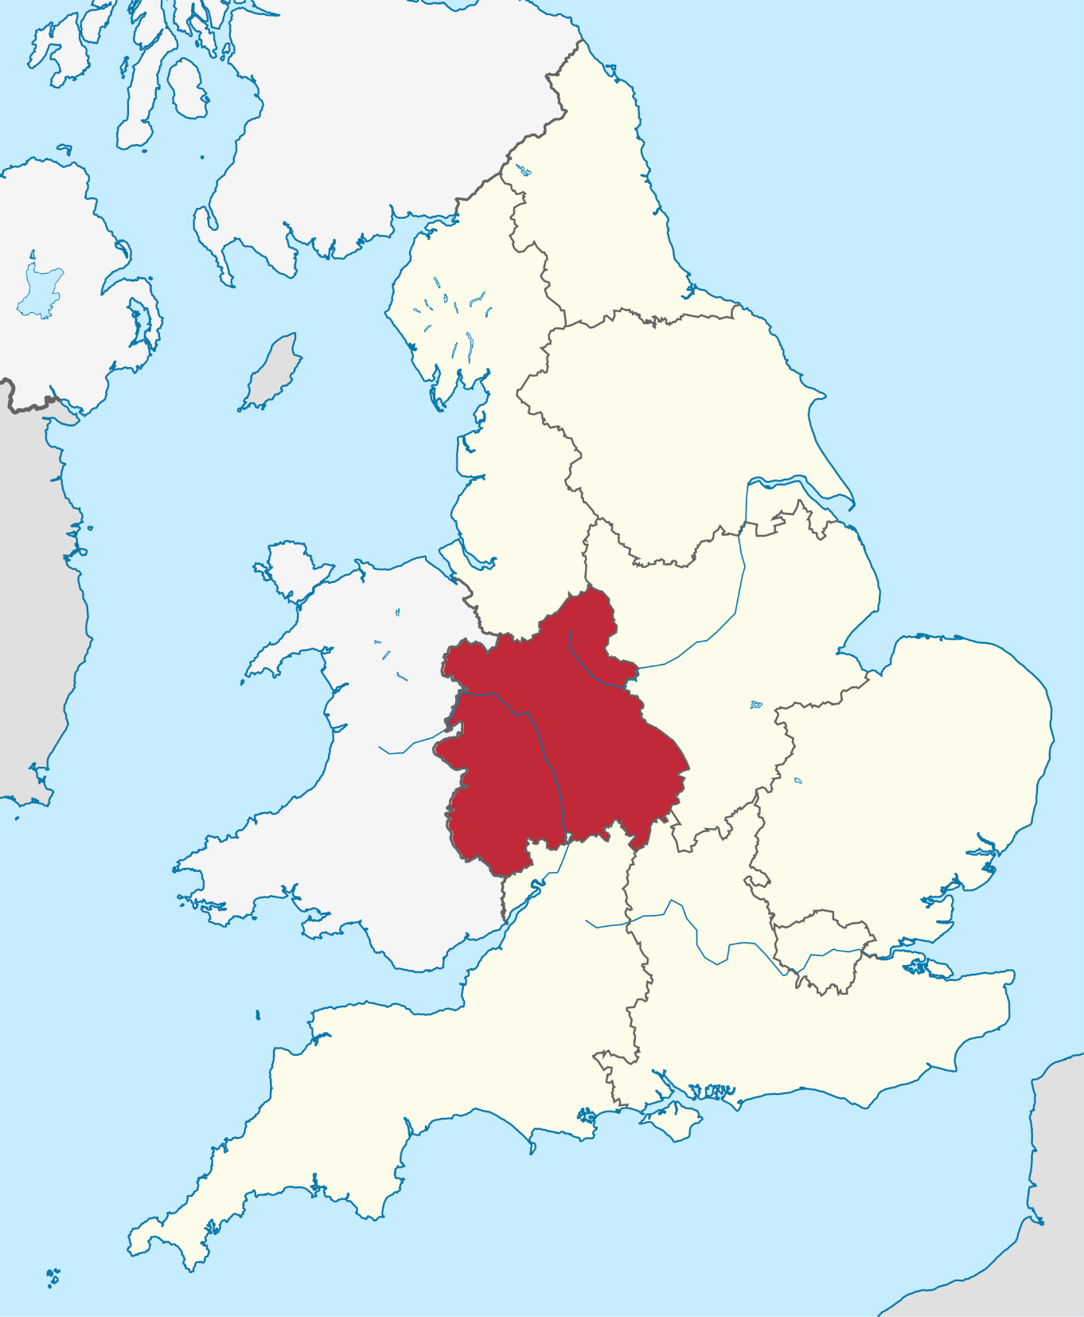
West Midlands Public Health Intelligence Group
Strong network to build from post NHS transition but challenges of the “unknown”
Changes in membership and dynamic over time to become more active
Facilitation from Public Health England and developing role of Local Knowledge and Intelligence Service

Slide 10
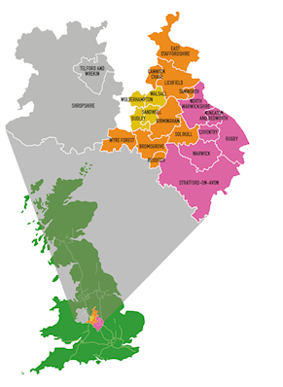
Challenges and successes of embedding wider social issues into economic agenda
Partnership work between local authorities, Public Health England local and national teams
Research and Intelligence group designing for the future

Slide 11
Common themes
Relationships across different professional bodies and establishing mutual benefit
Complex and messy – what are shared principles?
Trust and timeliness in use and re-use of information
Continual journey

