Slide 1
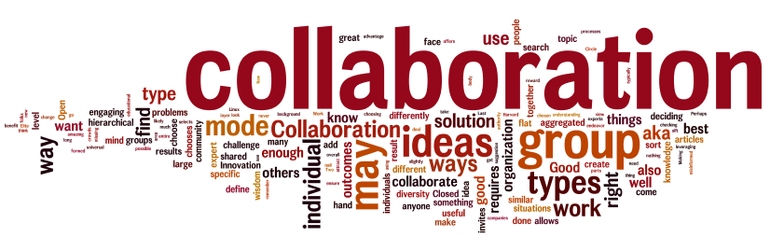





Collaborating to maximise impact
Jamie Jenkins
July 2016

Slide 2
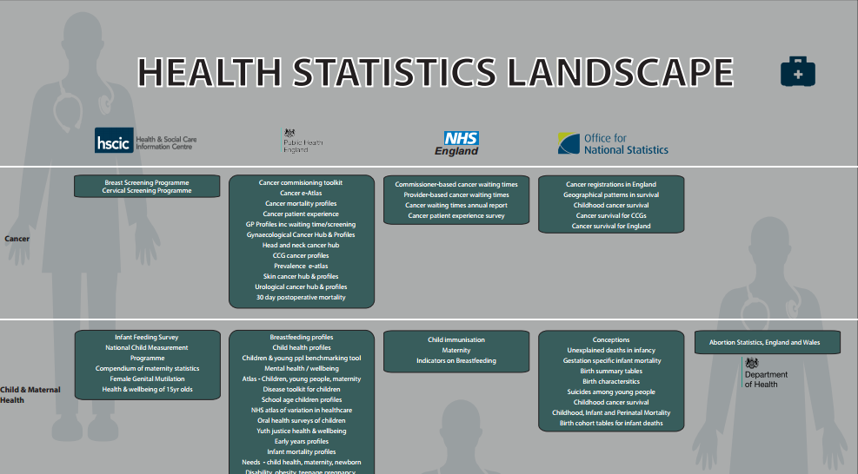
The health landscape

Slide 3
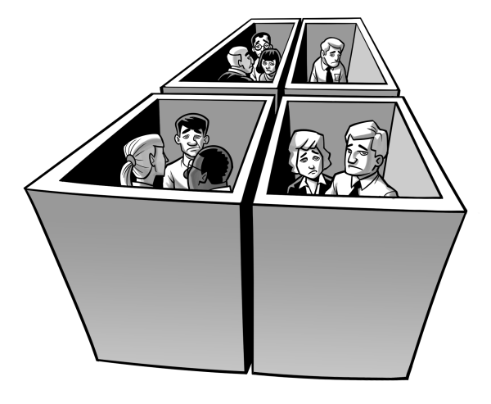
Working in Silos

Slide 4
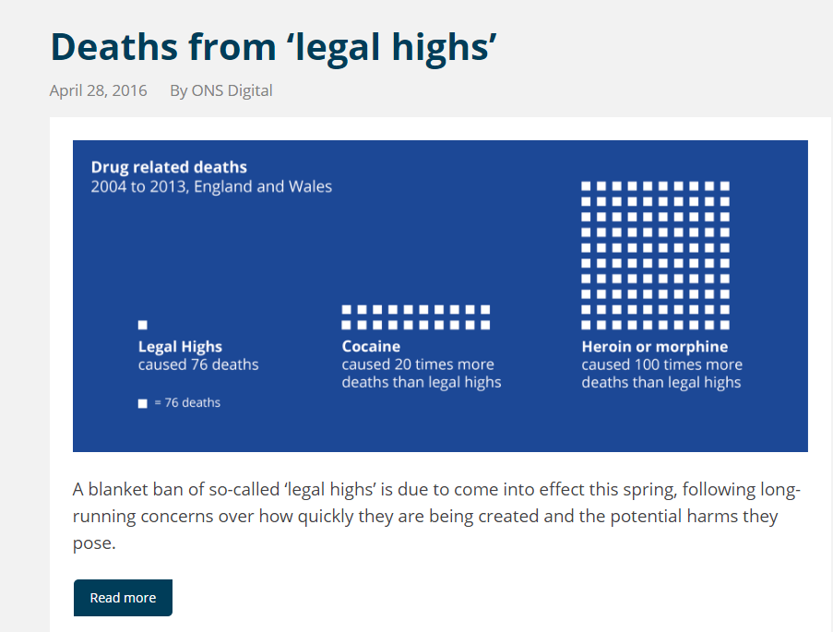
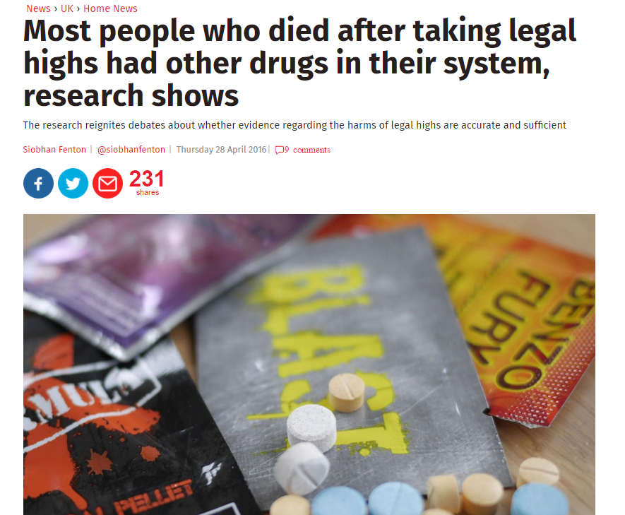


Working together – legal highs
Conversations with Home Office, Public Health England and Department for Health identified need for historical data on deaths through ‘legal highs’
Worked in collaboration with the policy departments to quality assure the analysis
“ Analysis will help the review of the Psychoactive Substances Act for which having more detailed information on deaths involving uncontrolled and controlled New Psychoactive Substances is useful”

Slide 5


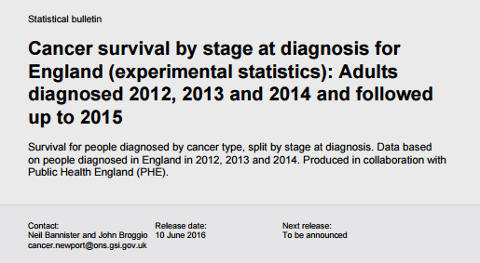


Cancer survival – working together to improve outcomes
Working across policy departments to ensure
indicators meet current and future demands

Slide 6
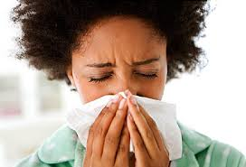
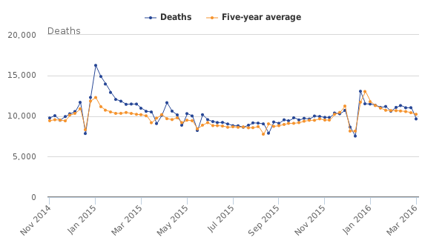
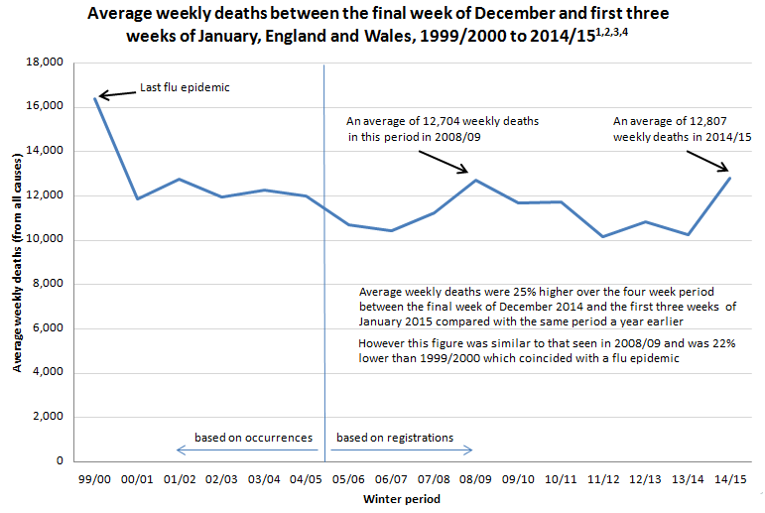
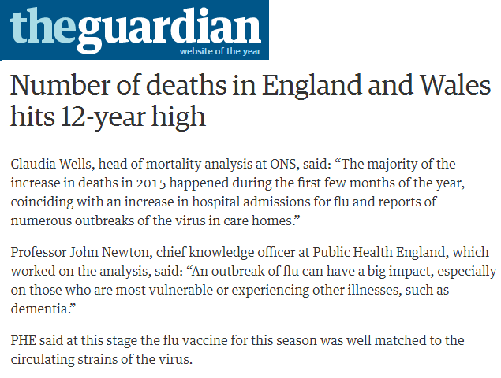
A spike in deaths

Slide 7


What next?
Alcohol related deaths
Smoking

Slide 8
Questions
What benefits could we and third parties expect from collaborations / partnerships and what might be the best way to structure these?
How can we best nurture collaboration between teams across government or in our own department so it becomes common place?

