Slide 1
Better Statistics, Better Decisions
A local government perspective
Juliet Whitworth
Research and Information Manager
8 July 2016
www.local.gov.uk

Slide 2
What Works Well and What Can Work Better?
How do authorities use data
What works well
What improvements are needed
What might be the benefits of improvement
www.local.gov.uk
Notes:
Local authorities are in an interesting position, being both providers of a lot of social care data (and some health data), as well as being consumers of it. Although in the main I’ll be talking from a user perspective, I’ll be dropping in some observations as providers as well.
All authorities use health, social care and other data in their Joint Strategic Needs Assessments, which they use to inform the commissioning of local health and care services; but also to inform other plans and the targeting of resources for a raft of other services.

Slide 3
What Works Well
Quality
www.local.gov.uk
Notes:
At the aggregated level there are tons of health related data published. I’d like to start with a positive, which is that the feedback I’ve had from everyone I’ve spoken to is that they value the quality of the health data provided. It’s something that HSCIC and PHE do particularly well. And it’s something that the Round Table concluded earlier in the year, that at its best the health and care statistical system in England is independent and professional, helpful, innovative and efficient with capable staff.

Slide 4
What Improvements are Needed?
Co-ordination
Alignment
Ease of use
Flexibility of outputs
Better use of existing data
Access to data
Communicate with users
www.local.gov.uk

Slide 5
What Improvements are Needed?
Speed of data
Minimise data burden
Co-ordination of policy
www.local.gov.uk

Slide 6
What are the benefits?
Greater understanding of issues and ability to act on them
Better integrated commissioning and delivery
Better forward planning
Other innovative uses of data
www.local.gov.uk

Slide 7
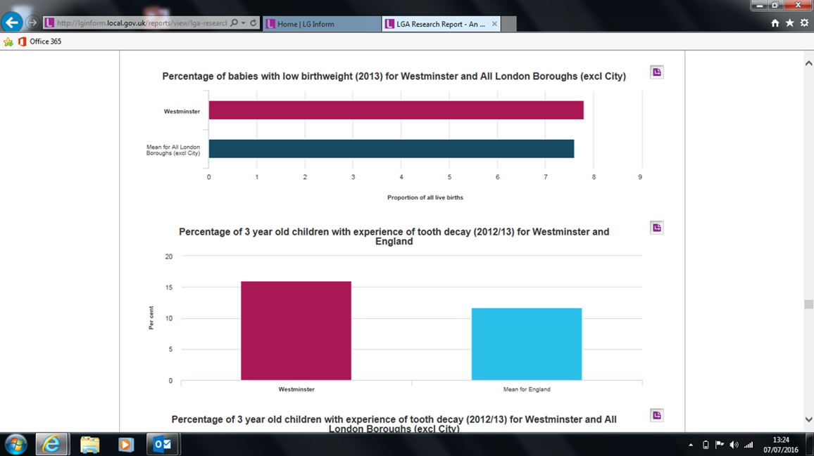
Contact details
juliet.whitworth@local.gov.uk
www.local.gov.uk/lginform

