Slide 1


Anomaly detection methods for alternative data sources in the CPI
Loes Charlton
Data Scientist
Methodology – Economic Statistics

Slide 2
Anomaly detection – what and why?
Data need to be complete and correct
  Flag anomalies/outliers (errors, unusual price changes)
  Too many anomalies could influence price indices
Locally collected data - 180k/month:
“The Tukey algorithm has been used in the production of our consumer prices statistics since 1987.”
2021: Alternative data sources:
  Scanner data – prices & quantities – 36m/month
  Web-scraped data – prices – 750k/week
Review
Automation
Consumer Prices Indices technical manual 2019

Slide 3
Methods to consider – literature review
Assumptions:
  Prices data typically follow a multimodal, otherwise undefined distribution; but are not highly multimodal/complex (Mayhew & Clews, 2016)
  We expect relatively few outliers (a small percentage).

Slide 4
Methods to consider – literature review
Method category | Examples | Advantages | Disadvantages | Suitable?
Distance-based | Minimum Covariance Determinant | Affine equivariant Robust estimator Fast & easy | Requires uni-modally distributed data | No
Density-based | Local Outlier Factor DBSCAN | Few assumptions Few parameters Fast & easy | Requires good-quality training data Requires parameters | Yes
Gaussian Mixture Modelling |  | Can capture covariance in non-spherical shapes Gives probability Fast & easy | Requires Gaussian data in an ellipsoid shape Requires a priori decision on no. clusters Only suitable if few outliers | Yes

Slide 5
Methods to consider – literature review
Method category | Examples | Advantages | Disadvantages | Suitable?
Principle Component Analysis |  | Well-known, available Few parameters | Which components contain outliers? Only suitable if few outliers | Yes
Entropy-based | EODSP ODAAE | Promising, current Lower false alarm rate Can be superior to unsupervised methods | Requires labelled data Not established Multiple parameters to set | No
Other machine & deep learning | OC-SVM Isolation Forest DAD models LSTM, CNN, RNN |  | OC-SVM: prop. of outliers needs to be set, many parameters Isolation Forest: does not perform well with clusters of different densities Deep learning: over-fitting for low-dimensional/simple data, computationally intensive | No

Slide 6
Methods to consider – short-list:
Method category | Examples | Advantages | Disadvantages | Suitable?
Density-based | Local Outlier Factor DBSCAN | Few assumptions Few parameters Fast & easy | Requires good-quality training data Requires parameters | Yes
Gaussian Mixture Modelling |  | Can capture covariance in non-spherical shapes Gives probability Fast & easy | Requires Gaussian data in an ellipsoid shape Requires a priori decision on no. clusters Only suitable if few outliers | Yes
Principle Component Analysis |  | Well-known, available Few parameters | Which components contain outliers? Only suitable if few outliers | Yes

Slide 7
Methods to consider – additional:
Method category | Examples | Advantages | Disadvantages | Suitable?
Tukey |  | Easy & straightforward Established | Positive skew | Yes
Filters | Low-sales filter Extreme price change filter Dumping filter | Common practice in NSIs | Arbitrary thresholds, might vary per product category Harder to be data-driven Which one(s)? | Yes
Timeseries analysis |  | Product or product group fluctuations taken into account Can flag unusual price changes | Need a considerable back-series Complex and computationally intensive | Yes

Slide 8
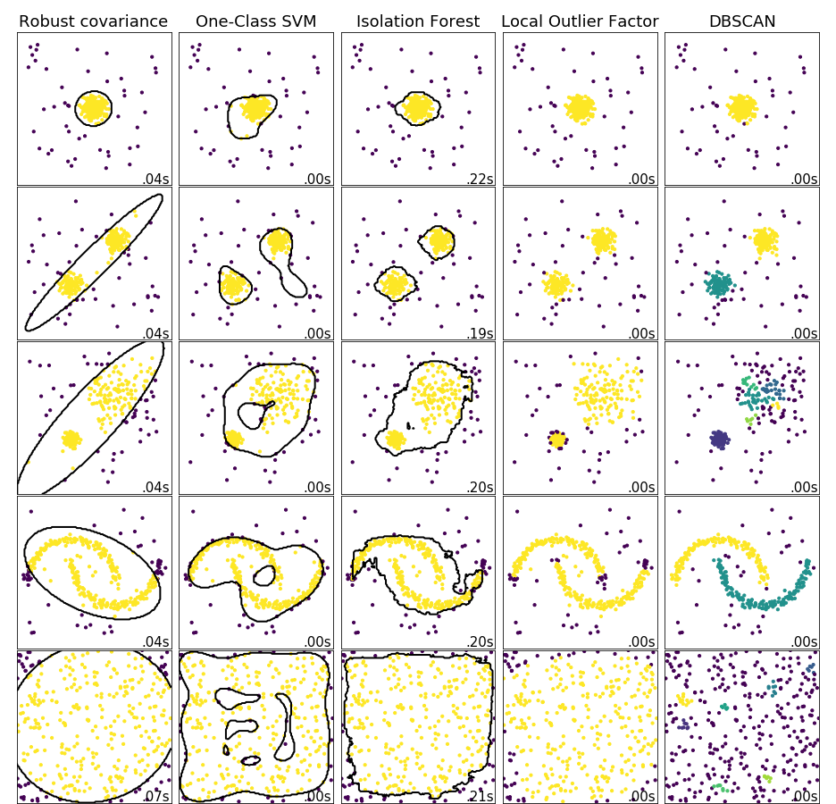
Data illustration
Performance for multi-modal clustering, especially multi-density clustering, is best for LOF & DBSCAN
DBSCAN prone to false-positives, though depends on eps parameter
Multi-density distributions
Colours = clusters, purple = outliers

Slide 9
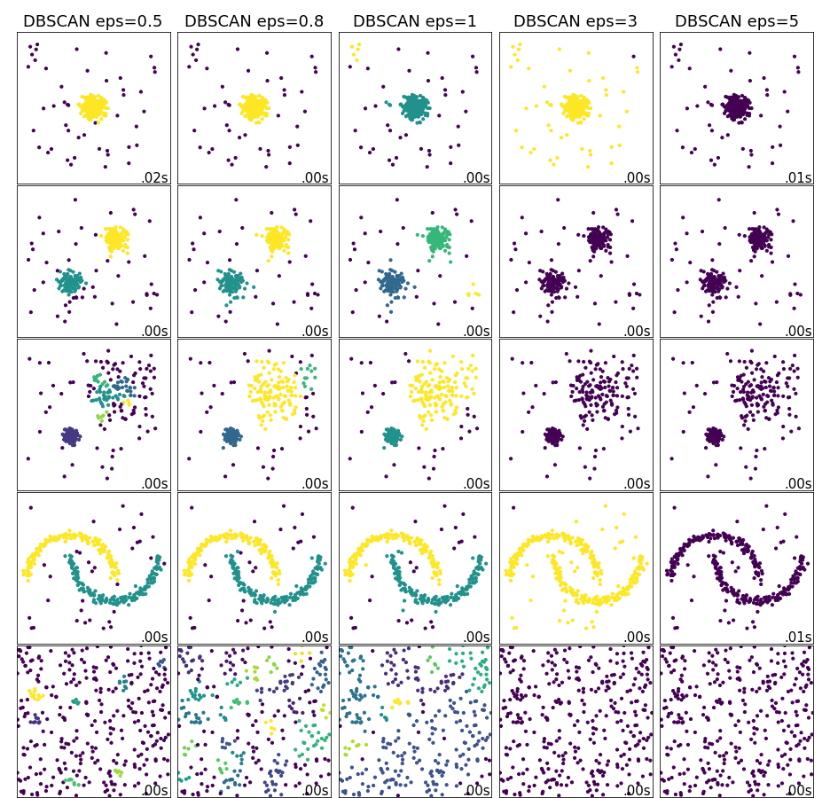
DBSCAN – eps parameter
DBSCAN can perform well, but is sensitive to eps:
  Too low: false positives
  Too high: false negatives
DBSCAN best method for more complex distributions
Multi-density distributions
Colours = clusters, purple = outliers

Slide 10
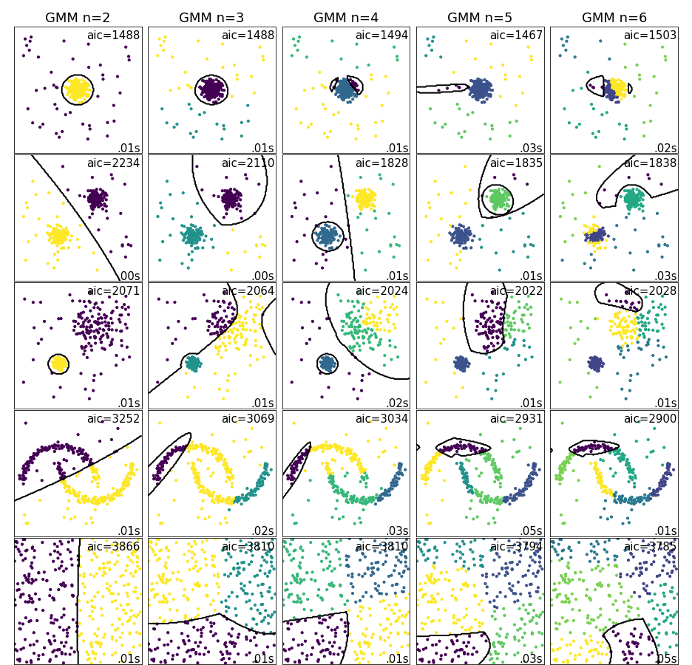
GMM – number of components
Low AIC = best performance
  Not perfect
GMM can perform well
  But difficult to set n_components
GMM did not perform well on multi-density clusters
Multi-density distributions
Colours = clusters

Slide 11
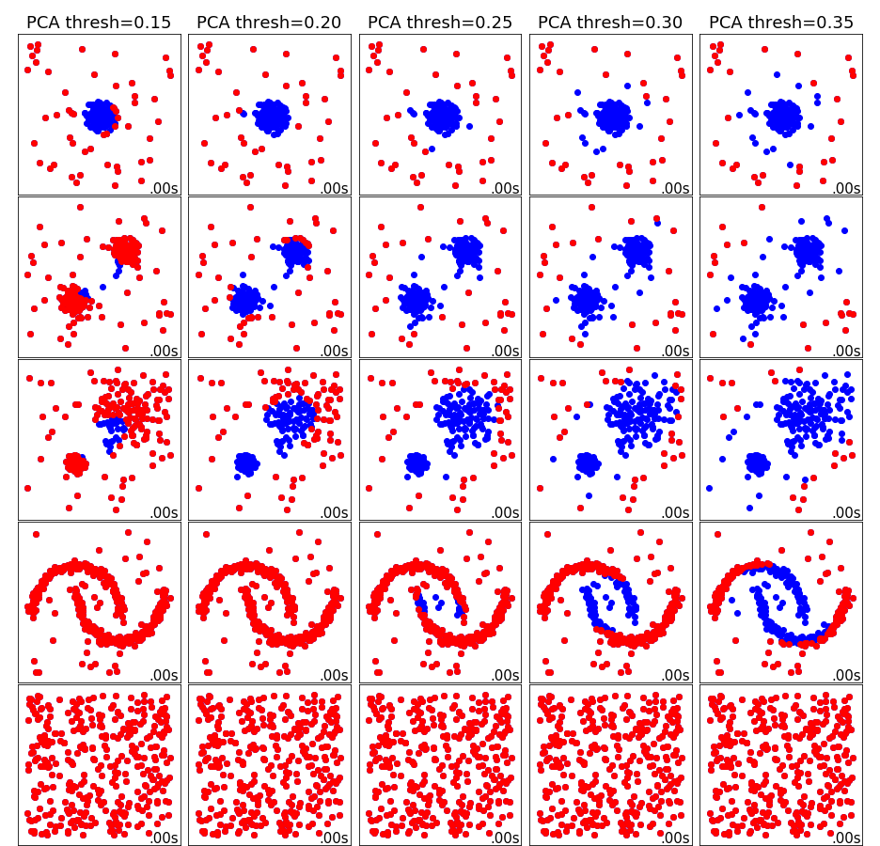
PCA – probability threshold
PCA performs well in uni and multi-modal distributions
  Underperforms in between clusters
Unclear how to set
  n_components
  Log probability threshold
Alternatives (var. explained, MSE) - did not improve
Multi-density distributions
Blue = inliers, red = outliers

Slide 12
Tukey
Calculate price relatives (t / t_base)
Sort ascending
Ratios of one (unchanged prices) are excluded
Trim top and bottom 5%
Obtain trimmed mean
Obtain upper and lower “midmeans”
Tukey limit: trimmed mean plus (or minus) 2.5 times the difference between the trimmed mean and the upper (or lower) midmean
Price changes > or < Tukey limits = outliers
Consumer Prices Indices technical manual 2019

Slide 13

Filters (price/quantity thresholds)
Low-sales filter options:
  Based on market share:
  Low-sale threshold:
    q_min=20 = used here.
Extreme price change filter:
  t / t-1: >300 % or <75%
Dumping filter:
  t / t-1: price <0.5 or >0.5 (AND)
  t / t-1: quantity <0.5 or >0.5
Białek, Jacek, and Maciej Beręsewicz. "Scanner data in inflation measurement: from raw data to price indices." arXiv preprint arXiv:2005.11233 (2020).
Grient, H.A., van der and de Haan, J. (2010), The use of supermarket scanner data in the Dutch CPI, Paper presented at the Joint ECE/ILO Workshop on Scanner Data, 10 May 2010, Geneva, Switzerland.

Slide 14
Methods compared – CPI grocery data
Computation time per timepoint, per product category:
 | Mean computation time (s) | Stdev computation time (s)
Tukey | 0.013 | 0.001
LOF | 0.001 | <0.001
DBSCAN | <0.001 | <0.001
GMM | 0.005 | 0.005
Low-sales filter | 0.02*
Extreme price change filter | 0.04*
Dumping filter | 0.05*
Web-scraped price relatives t/t-1: Ntimepoints=54, Nproducts=2521, Ngroups=458
* Filters are only run once on the whole dataset (no product categories required)

Slide 15
Methods compared – CPI grocery data
Number of outliers identified (across all timepoints):
 | Total number of outliers | Percentage of total data
Tukey | 258 | 0.19
LOF (n_n=100, c=0.01) | 5624* | 4.1
DBSCAN (eps=0.3) | 25371* | 19.0 – too much*
GMM | 65075 | 47.8 – too much
Low-sales filter (q<20) | 2360 | 1.7
Extreme price change filter (>300% | <75%) | 1 | <0.01
Dumping filter (<|>0.5) | 1 | <0.01
Web-scraped price relatives t/t-1: Ntimepoints=54, Nproducts=2521, Ngroups=458
* LOF and DBSCAN outputs are very sensitive to their parameter settings, numbers can easily be reduced following parameter tuning, more important are outlier distributions as per following slide

Slide 16
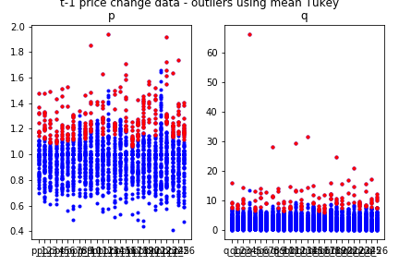
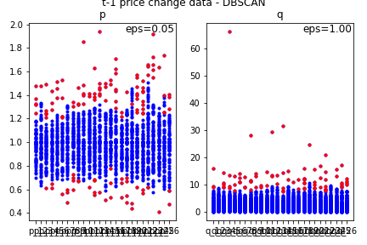
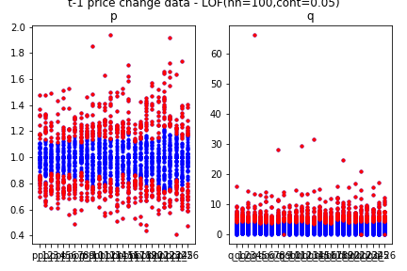
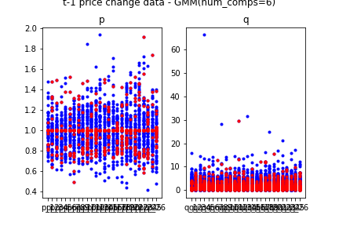
Outlier distributions compared
t / t-1 price relatives, 523 products x 27 months
Tukey
DBSCAN
Method dropped, as results comparable to DBSCAN but method is slower.
Method dropped, as results not sensible and unable to improve.
LOF
GMM
Time
Blue = inliers, red = outliers

Slide 17
Methods compared – CPI grocery data
Effect on price index (Rygeks-J, across time and product categories):
 | Mean difference to baseline | Std difference to baseline
Tukey | 0.007830 | 0.035027
LOF | ND | ND
DBSCAN (eps=0.3) | 0.007260 | 0.031620
GMM | ND | ND
Low-sales filter (q<20) | 0.002685 | 0.012224
Extreme price change filter (>300% | <75%) | 0.007532 | 0.034599
Dumping filter (<|>0.5) | 0.007532 | 0.034599
Web-scraped price relatives t/t-1: Ntimepoints=54, Nproducts=2521, Ngroups=458
Only product categories that had sufficient remaining data for all methods are compared (Ngroups=88)
Baseline = no outlier methods applied. ND = Not Done (these methods were dropped).

Slide 18
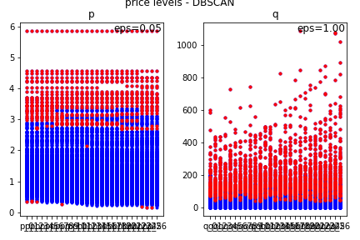
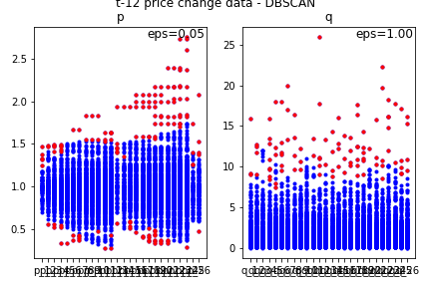
Price levels and relatives compared
DBSCAN, 523 products x 27 months
Price levels
Price relatives t / t-1
Price relatives t / t-12
Time
Not useful for DBSCAN/Tukey, however is useful for low-sales filter
Potentially useful for DBSCAN/Tukey and filters
Potentially useful for DBSCAN/Tukey and filters
Note: t / t-12 is actually base month (e.g., January),
So base month = up to t-12
Blue = inliers, red = outliers

Slide 19

Conclusions - anomaly detection in the CPI
Price levels
  Filters (low-sales): fast
Price relatives
  Filters (extreme sales + dumping): fast
  And/or
  Clustering or other outlier method
    DBSCAN an improvement over Tukey
    Slower due to need to run for each product
    category separately
    Potentially highly informative and automated

Slide 20
Further considerations – CPI grocery data
Scanner vs. web-scraped:
  Little difference in price data
  Scanner: quantities bring additional value
  Same approaches feasible
Platform feasibility
  Tukey & filters - easy
  Clustering methods - more difficult
Product categories/classification
  Methods other than filters need to be run within appropriate product categories (classification)

Slide 21
Work not yet done (1/2)
(Hyper-)parameter or threshold tuning
  This can greatly influence DBSCAN outlier results, in particular useful to bring down outlier numbers
  Can potentially also highly influence filter or Tukey results
Combination of filters + Tukey or clustering
  Additional effect of value?

Slide 22
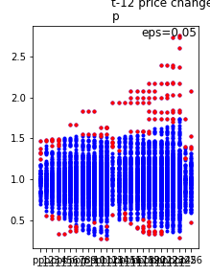
Work not yet done (2/2)
Timeseries analysis
  It is potentially important to analyse the price and quantity timeseries of a product or product category. This can show deviant time point entries that may be overlooked in single timepoint (monthly) outlier analysis where these deviations may be within the outlier criteria for the relevant category.
  Useful techniques to investigate are:
    Statistical profiling (mean/median plus standard deviation upper/lower bounds) – this is fastest and easiest and thus preferable if it works well enough;
    Predictive confidence level approach: e.g., ARIMA (autoregressive integrated moving average) forecasting using mean absolute percentage error – might give better results;
    Unsupervised clustering-based approach such as DBSCAN - might also be better and easy to implement.
Price relatives t / t-12
Time

Slide 23
Questions for the APCP technical panel
To further guide comparison, parameter tuning, and decisions on outlier methods, it would be very helpful to know what percentage of outliers we typically expect.
  Is there such a number?
  For scanner data vs. web-scraped data?
Under what conditions does outliering have an effect on the index?
  Are there economically viable scenarios where that is important?
  Should we safeguard against these scenarios?
At what stage of the index production pipeline would outliering be most effective?
  After classification, but before product grouping?
  What would be the influence of things like product returns?
  Are there any other considerations or recommendations?

Slide 24
References
Proof of concept AD method comparison code adapted from:
  https://scikit-learn.org/stable/auto_examples/miscellaneous/plot_anomaly_comparison.html#sphx-glr-auto-examples-miscellaneous-plot-anomaly-comparison-py
  https://scikit-learn.org/stable/auto_examples/cluster/plot_cluster_comparison.html#sphx-glr-auto-examples-cluster-plot-cluster-comparison-py
Mayhew & Clews, 2016. Using machine learning techniques to clean web scraped price data via cluster analysis. ONS Survey Methodology Bulletin. Spring 2016.
Białek, Jacek, and Maciej Beręsewicz. "Scanner data in inflation measurement: from raw data to price indices." arXiv preprint arXiv:2005.11233 (2020).
Grient, H.A., van der and de Haan, J. (2010), The use of supermarket scanner data in the Dutch CPI, Paper presented at the Joint ECE/ILO Workshop on Scanner Data, 10 May 2010, Geneva, Switzerland.

