Slide 1
Population and Social Statistics Transformation – an update
Becky Tinsley
Social Statistics Transformation, Analysis and Research (SSTAR)

Slide 2
Background, Timeline and Ambition

Slide 3
Background / Timeline
2011-2014
ONS’s ‘Beyond 2011’ project explores potential of administrative data for population and social statistics
2014
Conclusion of ‘Beyond 2011’ project. Recommendations to Government:
- online-first Census 2021
- identified need for government to facilitate data-sharing
Government response: “ambition is that censuses after 2021 will be conducted using other sources of data”
2017
Digital Economy Act opens legal gateway for cross-government data-sharing
2018
Census White Paper ‘Help Shape our Future’ – contains commitment that “in 2023, ONS will present recommendations to government as to the future of census arrangements”
2020
ONS transformation using admin data featured as case study in National Data Strategy. Integrated Data Programme also featured prominently
2021
Framework for assessing recommendation signed off
Plans to start engagement on the transformation journey (late 2021)
End 2022
Evidence delivered
Assessment of transformation to date and recommendation next steps
Internal scrutiny and preliminary recommendation
Preparation for wider consultation on outcomes
2023
Final consultation
Nov 2023: Recommendation made
Engagement

Slide 4
Key messages
We are transforming the way we produce population, migration and social statistics to:
  Produce more regular (monthly) and timely population totals by age and sex at a local level
  Provide more timely and regular small-area multivariate outputs each year (ultimate aim: more topics than a census can provide once a decade)
We will continue to demonstrate progress to users by:
  Publishing research as it develops
  Embedding new data and methods into our official statistics when we are confident in them
We will develop a system that is flexible to changes in data and technology and policy developments, and will be based on integrating a range of sources including commercial data
The 2023 Recommendation will show our progress, setting out a recommendation on what’s needed in future. The transformed system will continue to iteratively build on what we have achieved
This work will be instrumental in delivering the recommendations of the Inclusive Data Taskforce, and supporting government priorities. We have overlaps and synergies with all other ONS Programmes
Core user needs not readily available on admin data will need to be met. This could include:
  New topics collected on admin data
  Large surveys
  Need for another census in the future
Notes:
This is about improving the regularity and timeliness of our population and social statistics at a granular level
2023 Recommendation is a stepping stone along our transformation journey

Slide 5
User Needs
Essential / Core Needs
Ambitions
Population size, change and mobility
Population sub groups / protected characteristics
A more accessible and responsive system to user requirements
A system that is fully inclusive of the whole population
Supports an understanding of outcomes against characteristics, lived experiences and behaviours
– impacts on society, business/economy and the environment
Delivers faster indicators of morbidity, economic activity and population movement / change.
Housing and households / Families
Multi-variate relationships down to local level
Detail provided in EAP 157 (March 21 MARP)

Slide 6
Outcomes and Lived Experiences

Slide 7
Progress so far

Slide 8
Intro to Admin-based Population Estimates (ABPEs)
Version | Sources used | Rules applied
ABPEv1 | GP records (PR), National Insurance records (CIS), HESA data for students | Must be on PR and CIS Address allocated 50:50 if sources don’t agree unless on HESA (in which case students allocated 100% to student location)
ABPEv2 | PR, CIS, Eng/Welsh School Census (SC), HESA | Must be on 2 of 4 sources School-aged children allocated to SC address Students allocated to HESA address “Activity” info from DWP and health data (PDS) used to resolve conflicting addresses for adults
ABPEv3 | PDS, CIS, Benefits and Income data, School Census, HESA | “Hierarchy of belief” model – give preference to source most likely to cover a particular population group Use intelligence from all sources to act as “signs of life” (intended to only keep “active” records, and to assign geographically) Objective: remove over-coverage (strict rules)

Slide 9
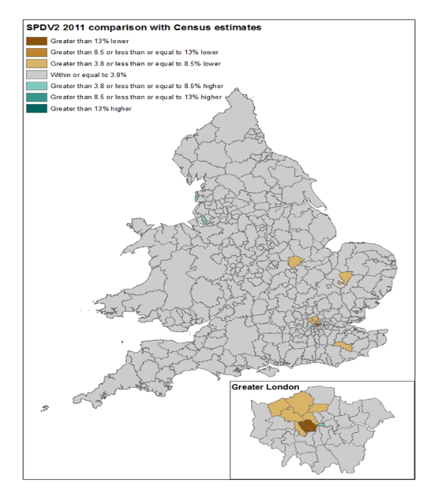
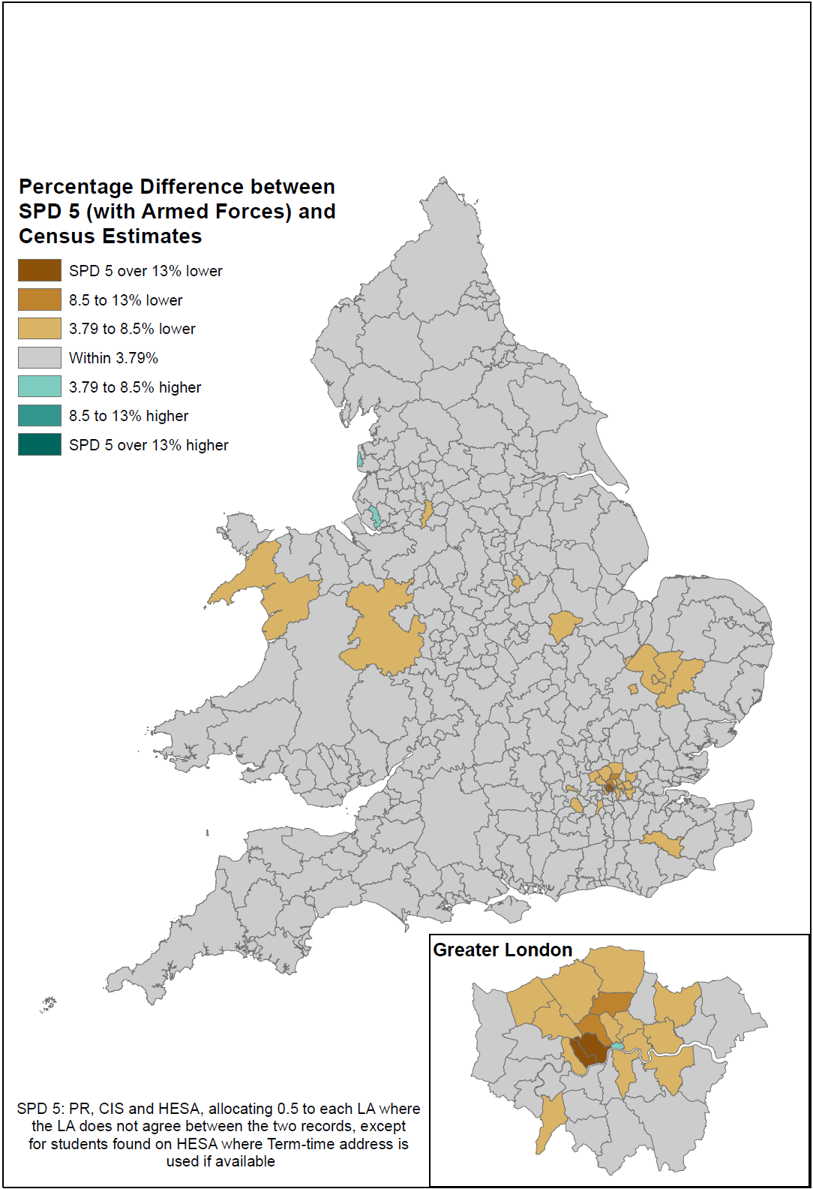
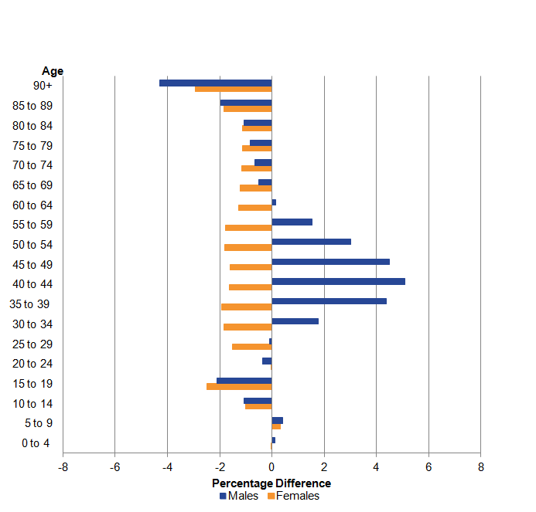
ABPE v1 comparison with 2011 Census population estimates
Basic rules
Includes limited datasets
Performance improved for LA totals…
But this hides patterns of over and under-coverage by age and sex:
Always have over-coverage of working age males
Problematic for estimator conditions eg DSE.
Percentage difference to Census, England and Wales, 2011
ABPE v2 comparison with 2011 Census population estimates
Refined rules
Includes wider range of dataset
So developed ABPEv3 which took a different approach and aimed to remove overcoverage

Slide 10
Population counts for ABPE v2 and v3 and MYE for females, by year of birth, 2016-2020
Shows how the cohort size for those aged c.18-40 builds over time for ABPEv2 – we think from list inflation on the admin data. This problem is reduced from stricter inclusion rules on ABPEv3. Can see under-coverage in ABPEv3 for older ages

Slide 11
Population counts for ABPE v2 and v3 and MYE for males, by year of birth, 2016-2020
Similar to females, shows how the cohort size for those aged c.18-50 builds over time for ABPEv2 – we think from list inflation on the admin data. This problem is reduced from stricter inclusion rules on ABPEv3 – however can now clearly see under-coverage compared to MYEs

Slide 12
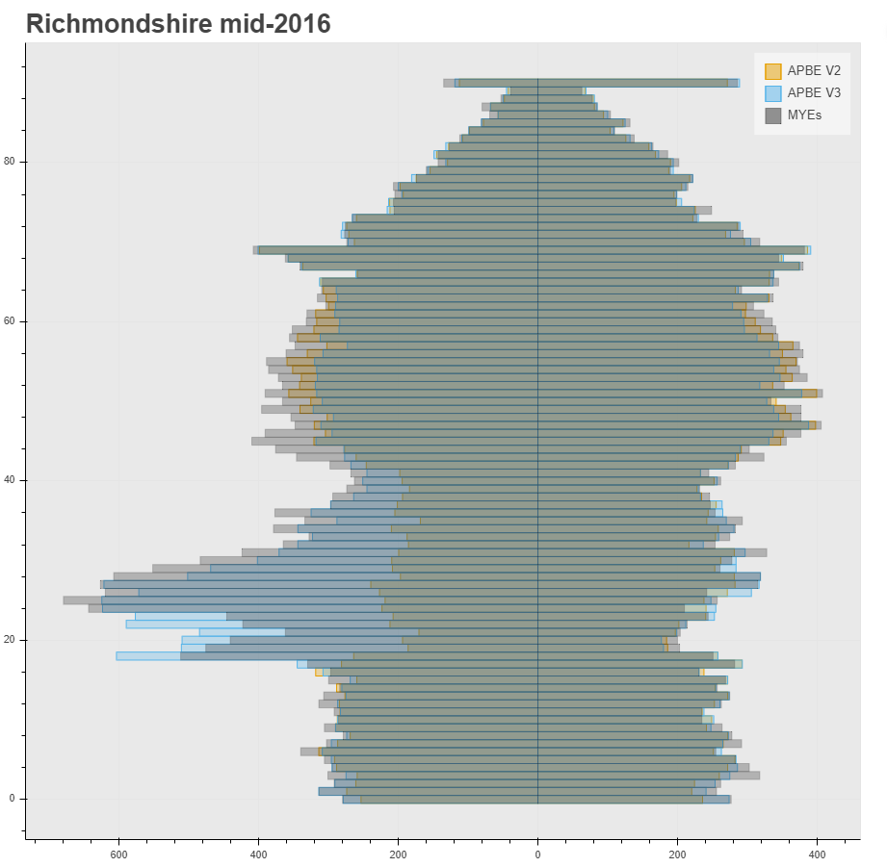
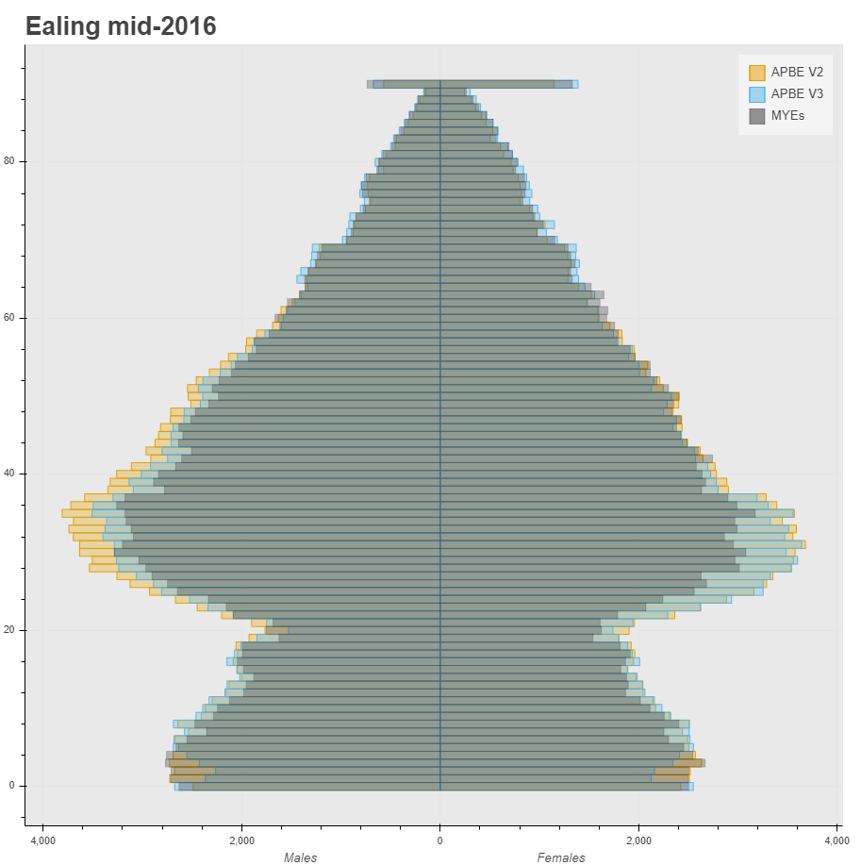
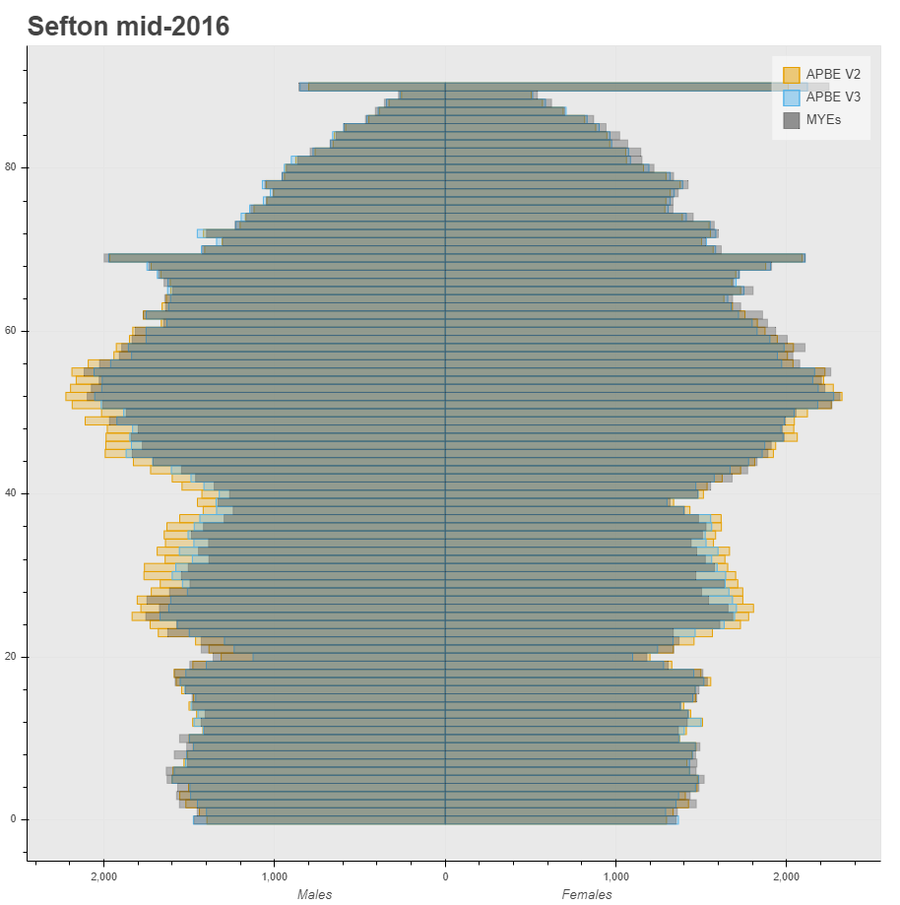
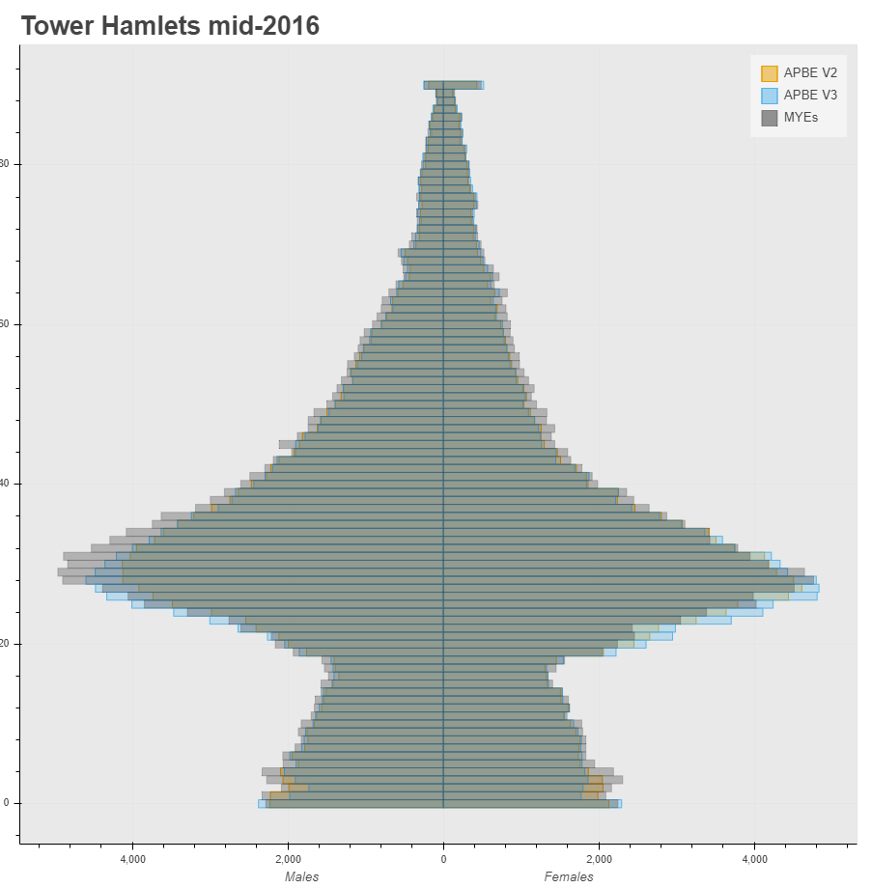
Grey bars – official Mid-Year Estimates
Yellow bars – ABPE v2
Blue bars – ABPE v3

Slide 13
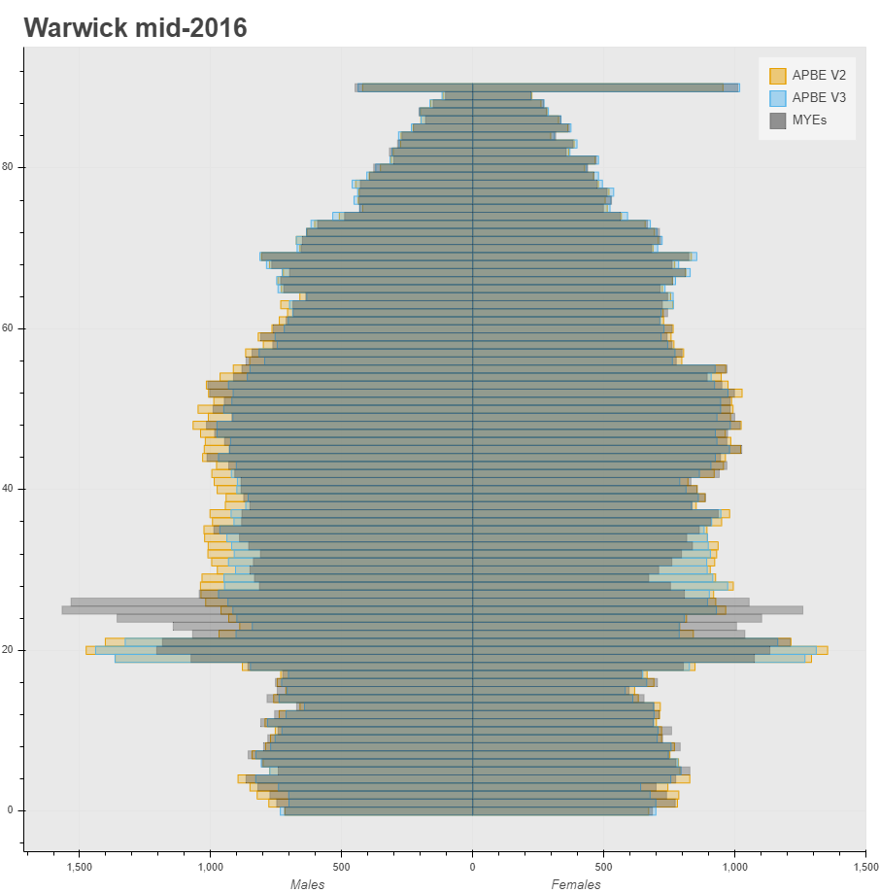
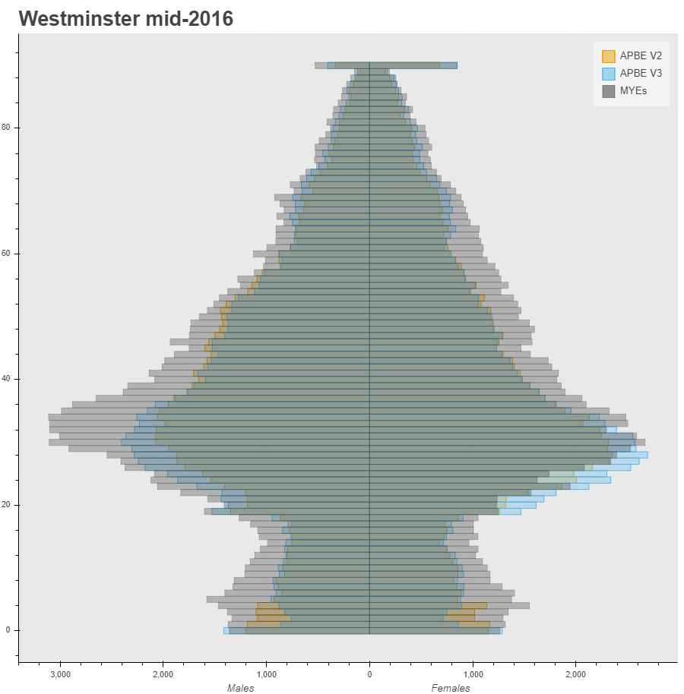
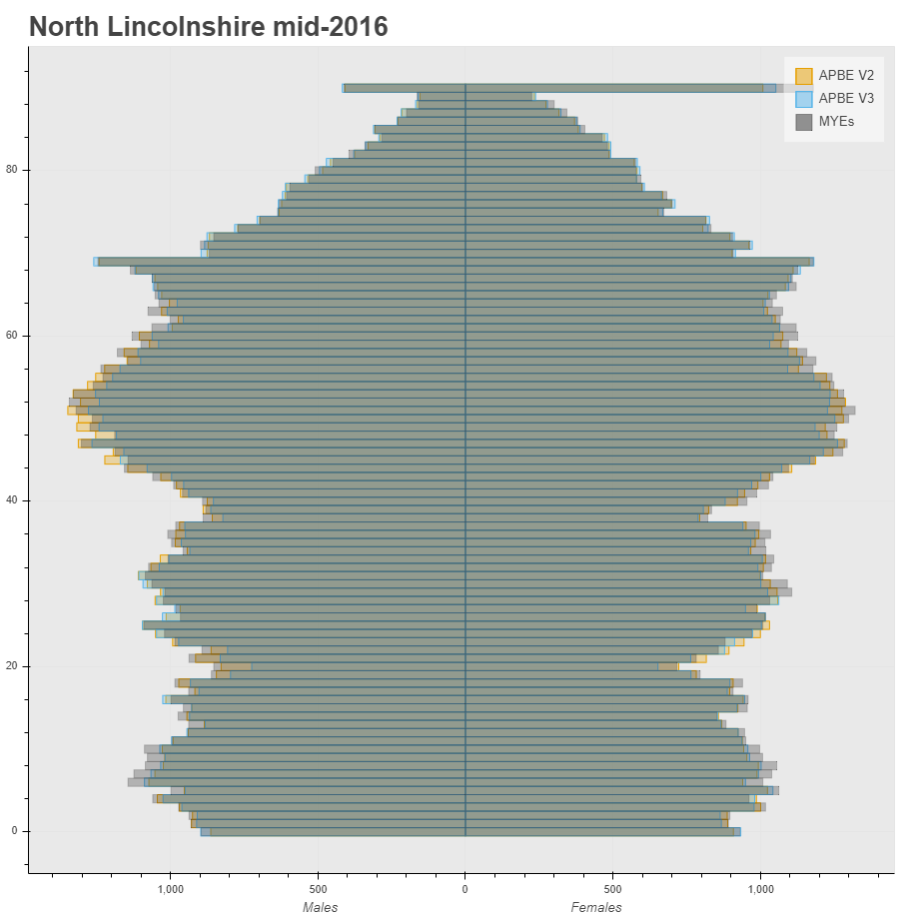
Grey bars – official Mid-Year Estimates
Yellow bars – ABPE v2
Blue bars – ABPE v3
Conclusion: Not a “one size fits all” approach

Slide 14
Giving users confidence: methodological solutions to tackle bias and variance in admin sources
Option | Pro | Con | Requirements
2021 Census Cohort Study | Replenished “census-type” dataset Allows us to follow records over time to look at outcomes Constructs outputs bottom-up | Misses any records not captured on admin data (imputation/weights could address) Potential to suffer from linkage error Not able to provide quality measures to users | Need all sources in the clear and dedicated clerical resource
Demographic accounting (Bayesian approach which uses a variety of different data sources as priors inc. population size, plus fertility rates, mortality rates, sex ratios etc) | Can maximise intelligence from all data sources (not just record-level) Provides quality measures Produces monthly “provisional” LA population totals Applies coherent population totals for other outputs | Needs record-level feeds to drive LA population estimates down to small area New approach – building expertise and testing | Dedicated methodological resource plus external expertise
ABPE supported by survey/estimation framework | Provides quality measures Allows production of small-area population totals Can adjust for population groups who don’t interact with admin sources | Potential to suffer from linkage error | Need all sources in the clear and dedicated clerical resource
Solution is likely to be a hybrid, borrowing strength from all three approaches, which is factored into our delivery plans

Slide 15
Approaches to improve ABPEs
Updated data sources
New data sources
Improved methods
Planning iterative phases over the next year, alongside availability of admin data

Slide 16
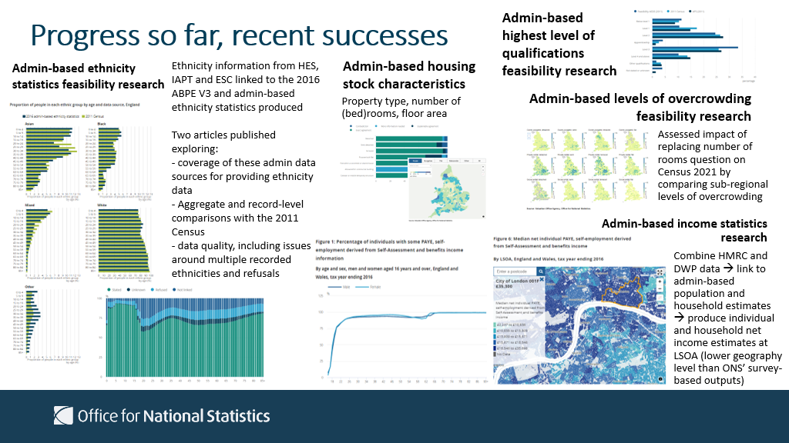
Characteristics,
Notes:
Due to publish feasibility research into Admin Based Labour Market Status (ABLMS) statistics on 9 Dec

Slide 17
Strategy for topics not readily available through admin data
Some topics are not readily available on admin data:
The proposed way forward will be factored into the 2023 Recommendation
Occupation
Religion
National identity
Welsh language
General health/self-defined disability
Unpaid care
Sexual orientation
Gender identity
Tenure/landlords

Slide 18
Engagement

Slide 19
Engagement
Engagement with users and stakeholders is vital – this represents an exciting but fundamental change to our statistical system
We are taking a two-phase:
  Within the next 6 months, starting a conversation with users via advisory groups, seeking their views on how our transformation plans are taking shape
  Nearer to the recommendation being made, we will ask users to engage with us on progress of transformation to date and the next steps

